Slide 1
Introduction to
Pattern Recognition
Subhadip Basu, Ph.D.
Department of Computer Science and Engineering,
Jadavpur University

Slide 2
What is pattern recognition?
“The assignment of a physical object or event to one of several pre-specified categories” - Duda & Hart
A pattern is an object, process or event that can be given a name.
A pattern class (or category) is a set of patterns sharing common attributes and usually originating from the same source.
During recognition (or classification) given objects are assigned to prescribed classes.
A classifier is a machine which performs classification.

Slide 3
Examples of applications
Handwritten: sorting letters by postal code, input device for PDA‘s.
Printed texts: reading machines for blind people, digitalization of text documents.
Optical Character Recognition (OCR)
Biometrics
Diagnostic systems
Military applications
Face recognition, verification, retrieval.
Finger prints recognition.
Speech recognition.
Medical diagnosis: X-Ray, EKG analysis.
Machine diagnostics, waster detection.
Automated Target Recognition (ATR).
Image segmentation and analysis (recognition from aerial or satelite photographs).

Slide 4
Two Schools of Thought
Statistical Pattern Recognition
The data is reduced to vectors of numbers
and statistical techniques are used for
the tasks to be performed.
2. Structural Pattern Recognition
The data is converted to a discrete structure
(such as a grammar or a graph) and the
techniques are related to computer science
subjects (such as parsing and graph matching).

Slide 5
In this course
1. How should objects to be classified be
represented?
2. What algorithms can be used for recognition
(or matching)?
3. How should learning (training) be done?

Slide 6
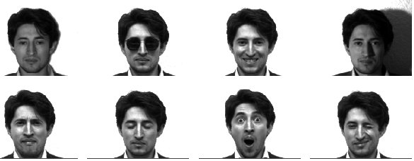
Examples of Patterns
Patterns with variations:
1. Expression –geometric deformation
2. lighting --- photometric deformation
3. 3D pose transform
4. Noise and occlusion

Slide 7
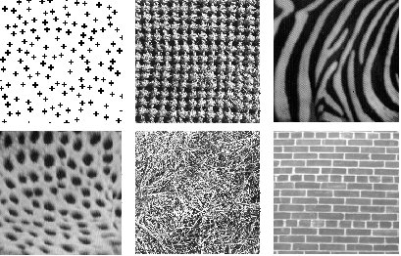
Examples of Patterns
A wide variety of texture patterns are generated by various stochastic processes.
How are these patterns represented in human brain?

Slide 8
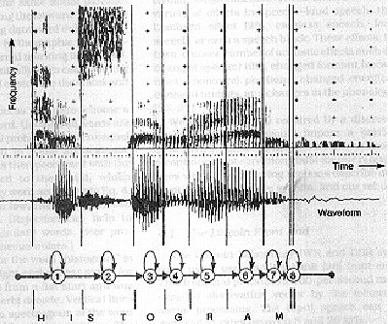
Examples of Patterns
Speech signal and Hidden Markov model

Slide 9
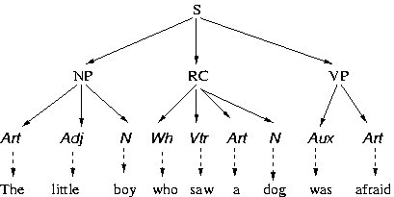
Examples of Patterns
Natural language and stochastic grammar.

Slide 10
Classification in Statistical PR
A class is a set of objects having some important
properties in common
A feature extractor is a program that inputs the
data (image) and extracts features that can be
used in classification.
A classifier is a program that inputs the feature
vector and assigns it to one of a set of designated
classes or to the “reject” class.
With what kinds of classes do you work?

Slide 11
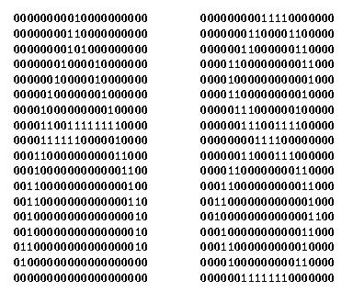
Feature Vector Representation
X=[x₁, x₂, … , x_{n}], each x_{j} a real number
x_{j} may be an object measurement
x_{j} may be count of object parts
Example: object rep. [#holes, #strokes, moments, …]

Slide 12
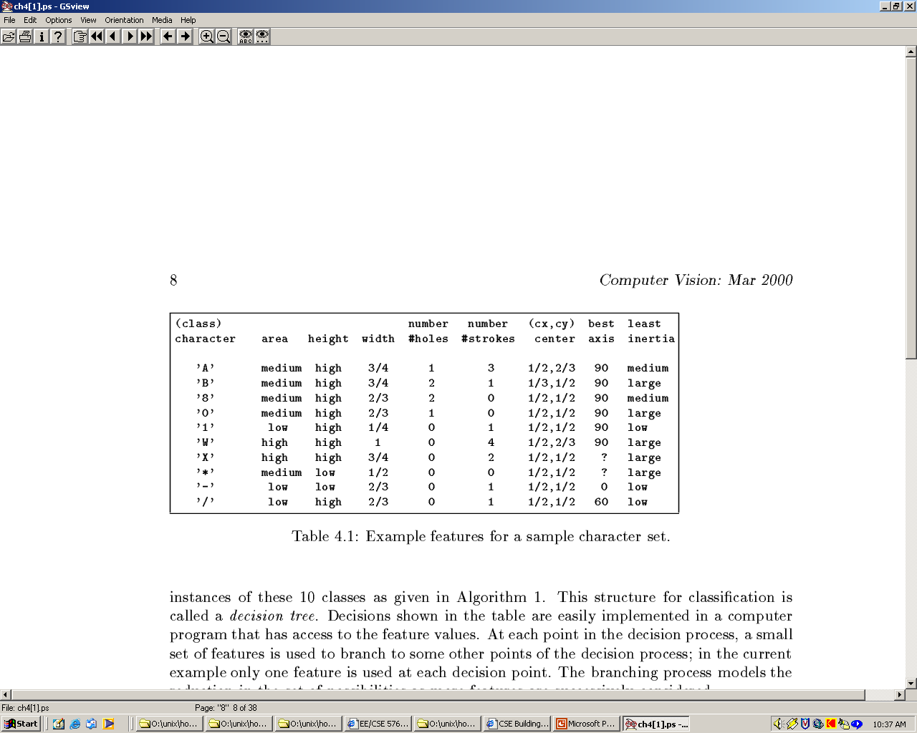
Possible features for char rec.

Slide 13
Some Terminology
Classes: set of m known categories of objects
(a) might have a known description for each
(b) might have a set of samples for each
Reject Class:
a generic class for objects not in any of
the designated known classes
Classifier:
Assigns object to a class based on features

Slide 14
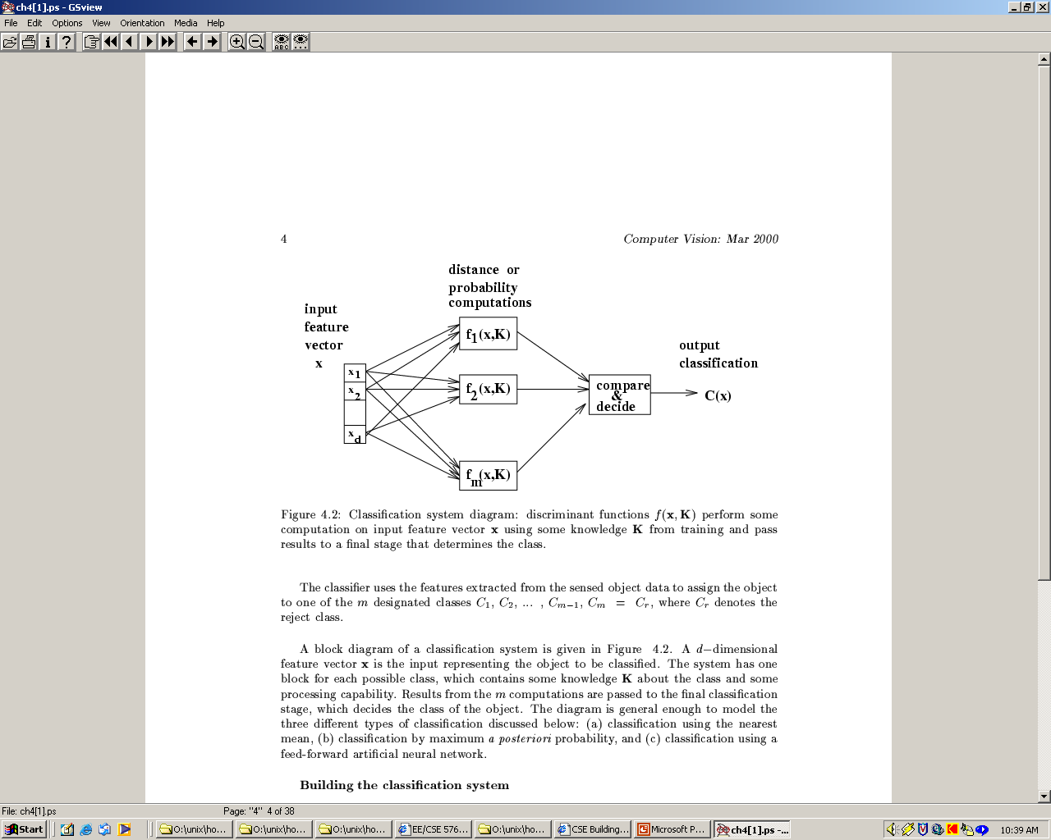
Discriminant functions
Functions f(x, K) perform some computation on feature vector x
Knowledge K from training or programming is used
Final stage determines class

Slide 15
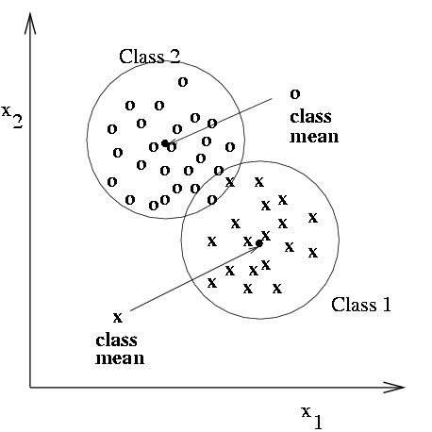
Classification using nearest class mean
Compute the Euclidean distance between feature vector X and the mean of each class.
Choose closest class, if close enough (reject otherwise)

Slide 16
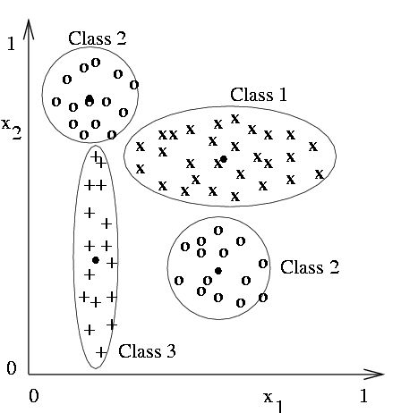
Nearest mean might yield poor results with complex structure
Class 2 has two modes; where is
its mean?
But if modes are detected, two subclass mean vectors can be used

Slide 17
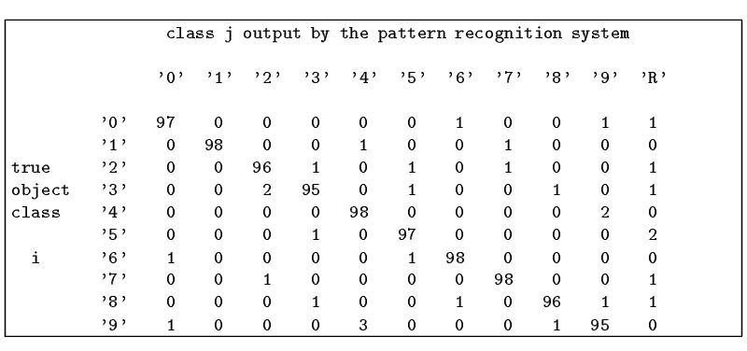
Confusion matrix shows empirical performance
Confusion may be unavoidable between some classes,
for example, between 9’s and 4’s.

Slide 18
Popularly used Classifiers
Decision Tree Classifiers
Nearest Neighbour Classifier
Artificial Neural Net Classifiers
Bayesian Classifiers and Bayesian Networks
(Graphical Models)
Support Vector Machines

Slide 19
Decision Trees
#holes
0
2
1
moment of
inertia
#strokes
#strokes
< t
≥ t
0
1
best axis
direction
#strokes
0
1
0
90
2
4
60
- / 1 x w 0 A 8 B

Slide 20
Decision Tree Characteristics
Training
How do you construct one from training data?
2. Strengths
Easy to Understand
3. Weaknesses
Overtraining

Slide 21
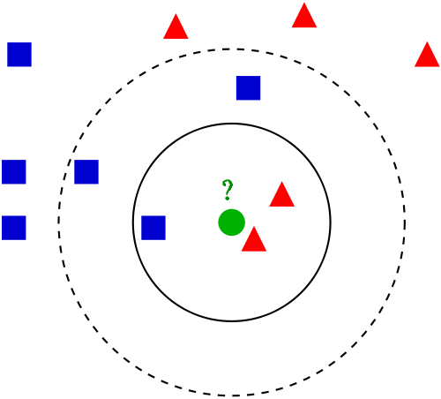
Nearest Neighbor Classification
Keep all the training samples in some efficient
look-up structure.
Find the nearest neighbor of the feature vector
to be classified and assign the class of the neighbor.
Can be extended to K nearest neighbors.
The test sample (green circle) should be classified either to the first class of blue squares or to the second class of red triangles. If k = 3 it is assigned to the second class because there are 2 triangles and only 1 square inside the inner circle. If k = 5 it is assigned to the first class (3 squares vs. 2 triangles inside the outer circle).

Slide 22
Artificial Neural Nets
Artificial Neural Nets (ANNs) are networks of
artificial neuron nodes, each of which computes
a simple function.
An ANN has an input layer, an output layer, and
“hidden” layers of nodes.
.
.
.
.
.
.
Outputs
Inputs

Slide 23
Node Functions
a1
a2
aj
an
w(1,i)
neuron i
output
w(j,i)
output = g (∑ aj * w(j,i) )
Function g is commonly a step function, sign function,
or sigmoid function (see text).

Slide 24
Support Vector Machines (SVM)
Support vector machines are learning algorithms
that try to find a hyperplane that separates
the differently classified data the most.
They are based on two key ideas:
Maximum margin hyperplanes
A kernel ‘trick’.

Slide 25
Maximal Margin
1
Margin
0
1
1
0
0
1
Hyperplane
0
Find the hyperplane with maximal margin for all
the points. This originates an optimization problem
which has a unique solution (convex problem).

Slide 26
Non-separable data
0
1
0
0
0
1
1
0
1
0
1
0
1
0
1
1
0
0
0
1
0
What can be done if data cannot be separated with a
hyperplane?

Slide 27
The kernel trick
The SVM algorithm implicitly maps the original
data to a feature space of possibly infinite dimension
in which data (which is not separable in the
original space) becomes separable in the feature space.
Original space R^{k}
Feature space R^{n}
1
0
1
1
0
0
1
0
0
1
0
Kernel
trick
0
1
0
0
0
1
1

Slide 28
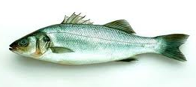
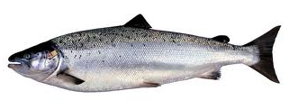
A Classical Example of
Pattern Recognition
“Sorting incoming Fish on a conveyor according to species using optical sensing”
Sea bass
Species
Salmon

Slide 29
Problem Analysis
  Set up a camera and take some sample images to extract features
    Length
    Lightness
    Width
    Number and shape of fins
    Position of the mouth, etc…
    This is the set of all suggested features to explore for use in our classifier!

Slide 30
Preprocessing
  Use a segmentation operation to isolate fishes from one another and from the background
Information from a single fish is sent to a feature extractor whose purpose is to reduce the data by measuring certain features
The features are passed to a classifier

Slide 31
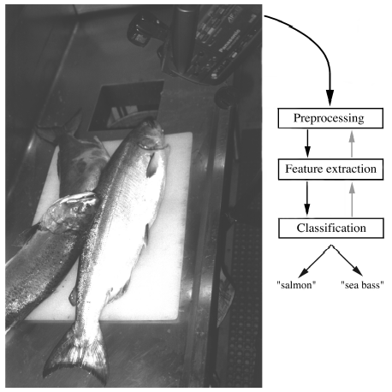

Slide 32
Classification
  Select the length of the fish as a possible feature for discrimination

Slide 33
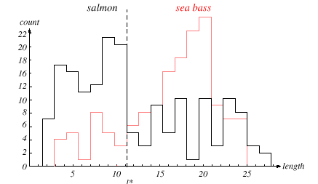

Slide 34
The length is a poor feature alone!
Select the lightness as a possible feature.

Slide 35
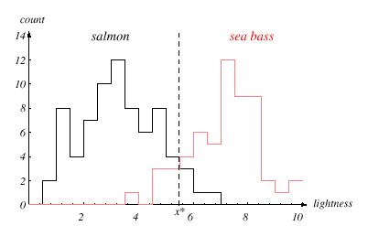

Slide 36
Threshold decision boundary and cost relationship
  Move our decision boundary toward smaller values of lightness in order to minimize the cost (reduce the number of sea bass that are classified salmon!)
  Task of decision theory

Slide 37
Adopt the lightness and add the width of the fish
Fish x^{T} = [x₁, x₂]
Lightness
Width

Slide 38
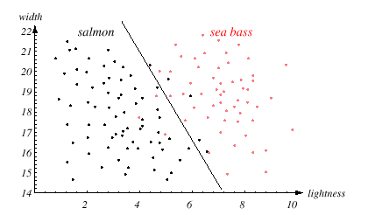

Slide 39
We might add other features that are not correlated with the ones we already have. A precaution should be taken not to reduce the performance by adding such “noisy features”
Ideally, the best decision boundary should be the one which provides an optimal performance such as in the following figure:

Slide 40
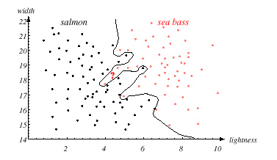

Slide 41
However, our satisfaction is premature because the central aim of designing a classifier is to correctly classify novel input
Issue of generalization!

Slide 42
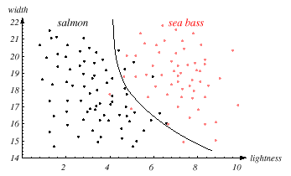

Slide 43
Pattern Recognition Systems
Sensing
  Use of a transducer (camera or microphone)
  PR system depends of the bandwidth, the resolution sensitivity distortion of the transducer
Segmentation and grouping
  Patterns should be well separated and should not overlap

Slide 44
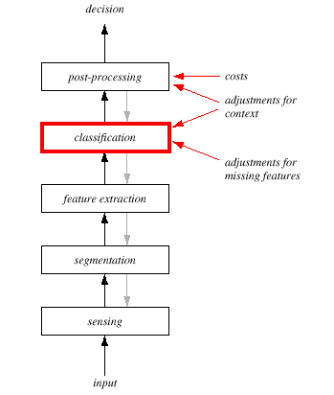

Slide 45
Feature extraction
  Discriminative features
  Invariant features with respect to translation, rotation and scale.
Classification
  Use a feature vector provided by a feature extractor to assign the object to a category
Post Processing
  Exploit context input dependent information other than from the target pattern itself to improve performance

Slide 46
The Design Cycle
Data collection
Feature Choice
Model Choice
Training
Evaluation
Computational Complexity

Slide 47
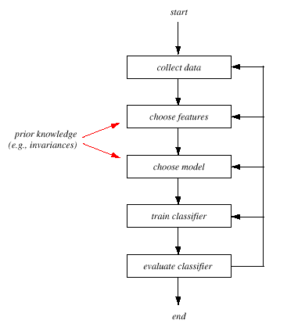

Slide 48
Data Collection
  How do we know when we have collected an adequately large and representative set of examples for training and testing the system?

Slide 49
Feature Choice
  Depends on the characteristics of the problem domain. Simple to extract, invariant to irrelevant transformation insensitive to noise.

Slide 50
Model Choice
  Unsatisfied with the performance of our fish classifier and want to jump to another class of model

Slide 51
Training
  Use data to determine the classifier. Many different procedures for training classifiers and choosing models

Slide 52
Evaluation
  Measure the error rate (or performance and switch from one set of features to another one

Slide 53
Computational Complexity
  What is the trade-off between computational ease and performance?
  (How an algorithm scales as a function of the number of features, patterns or categories?)

Slide 54
Learning and Adaptation
Supervised learning
  A teacher provides a category label or cost for each pattern in the training set
Unsupervised learning
  The system forms clusters or “natural groupings” of the input patterns

Slide 55
Conclusion
Reader seems to be overwhelmed by the number, complexity and magnitude of the sub-problems of Pattern Recognition
Many of these sub-problems can indeed be solved
Many fascinating unsolved problems still remain

